Slide 1
Access to Virtual Classrooms for courses and exams
https://ecorsi.liuc.it

Slide 2
1) Choose ENGLISH
2) Enter the LOGIN credentials and endorse the platform’s policy

Slide 3
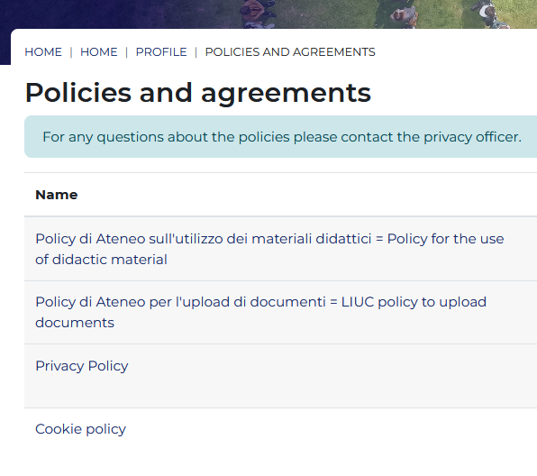
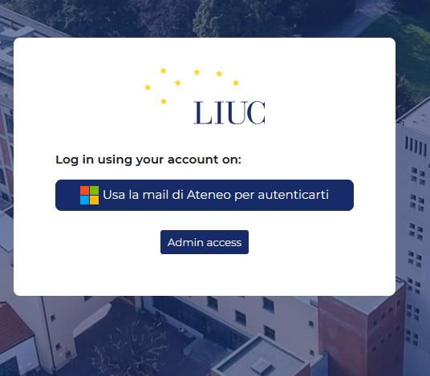
Login and endorse the platform policies

Slide 4
Enter your courses

Slide 5
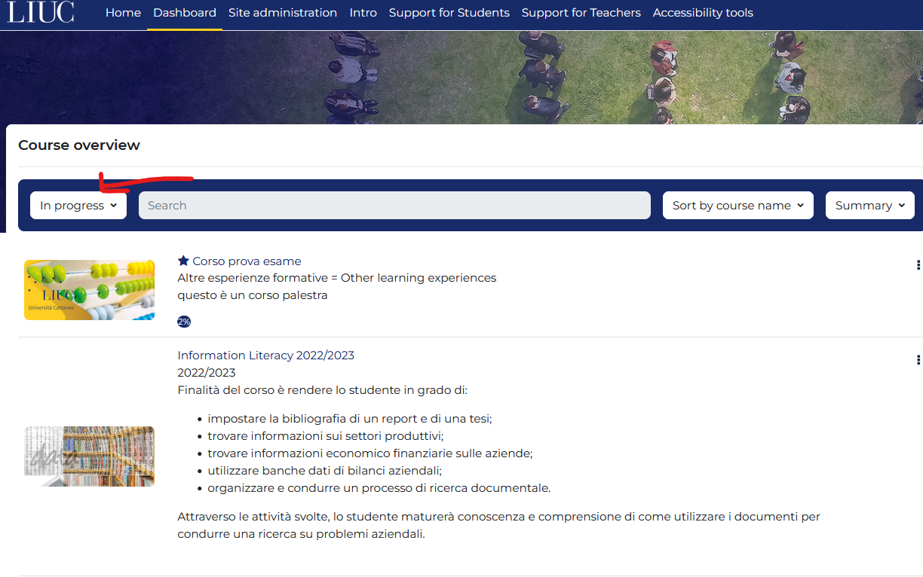

Slide 6
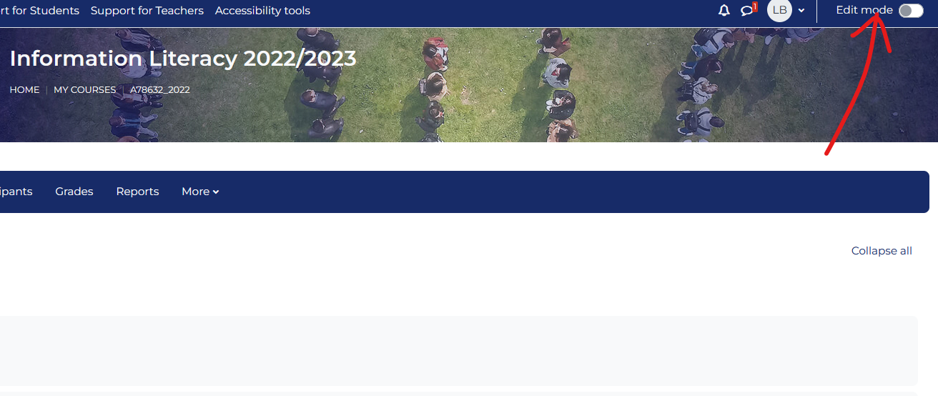

Slide 7
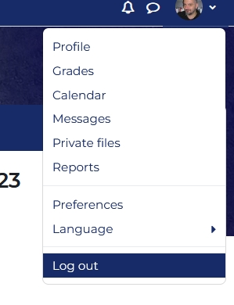
When the work is completed:
Logout: click on «Log out»
If you use shared devices, remember to close the browser up.
SUPPORT LIUC library lballestra@liuc.it arefraschini@liuc.it Tel. 0331572265

